Slide 1
Students’ Final Projects for 2025 Spring-UVA-CS GenAI Foundation and Application Overviews
Course:
https://qiyanjun.github.io/2025sp-GenAI-overview/
Project Github:
https://github.com/Qdata4Capstone/uva-25-spring-genai-students-projects

Slide 2
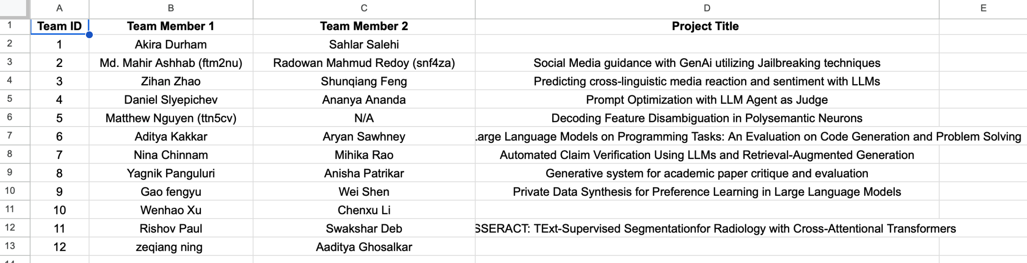
Writing assistant agent
Blogpost writing assistant agent
Toxicity guard

Slide 3
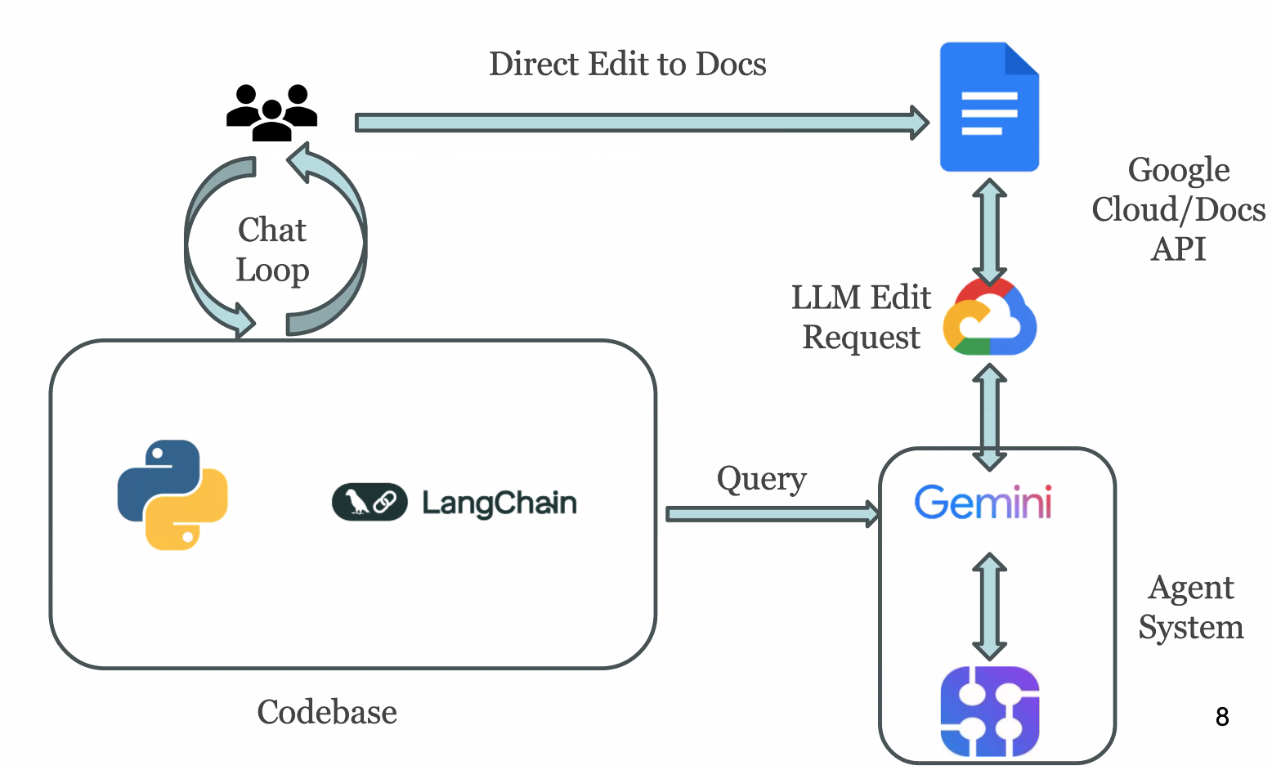
Team 1

Slide 4
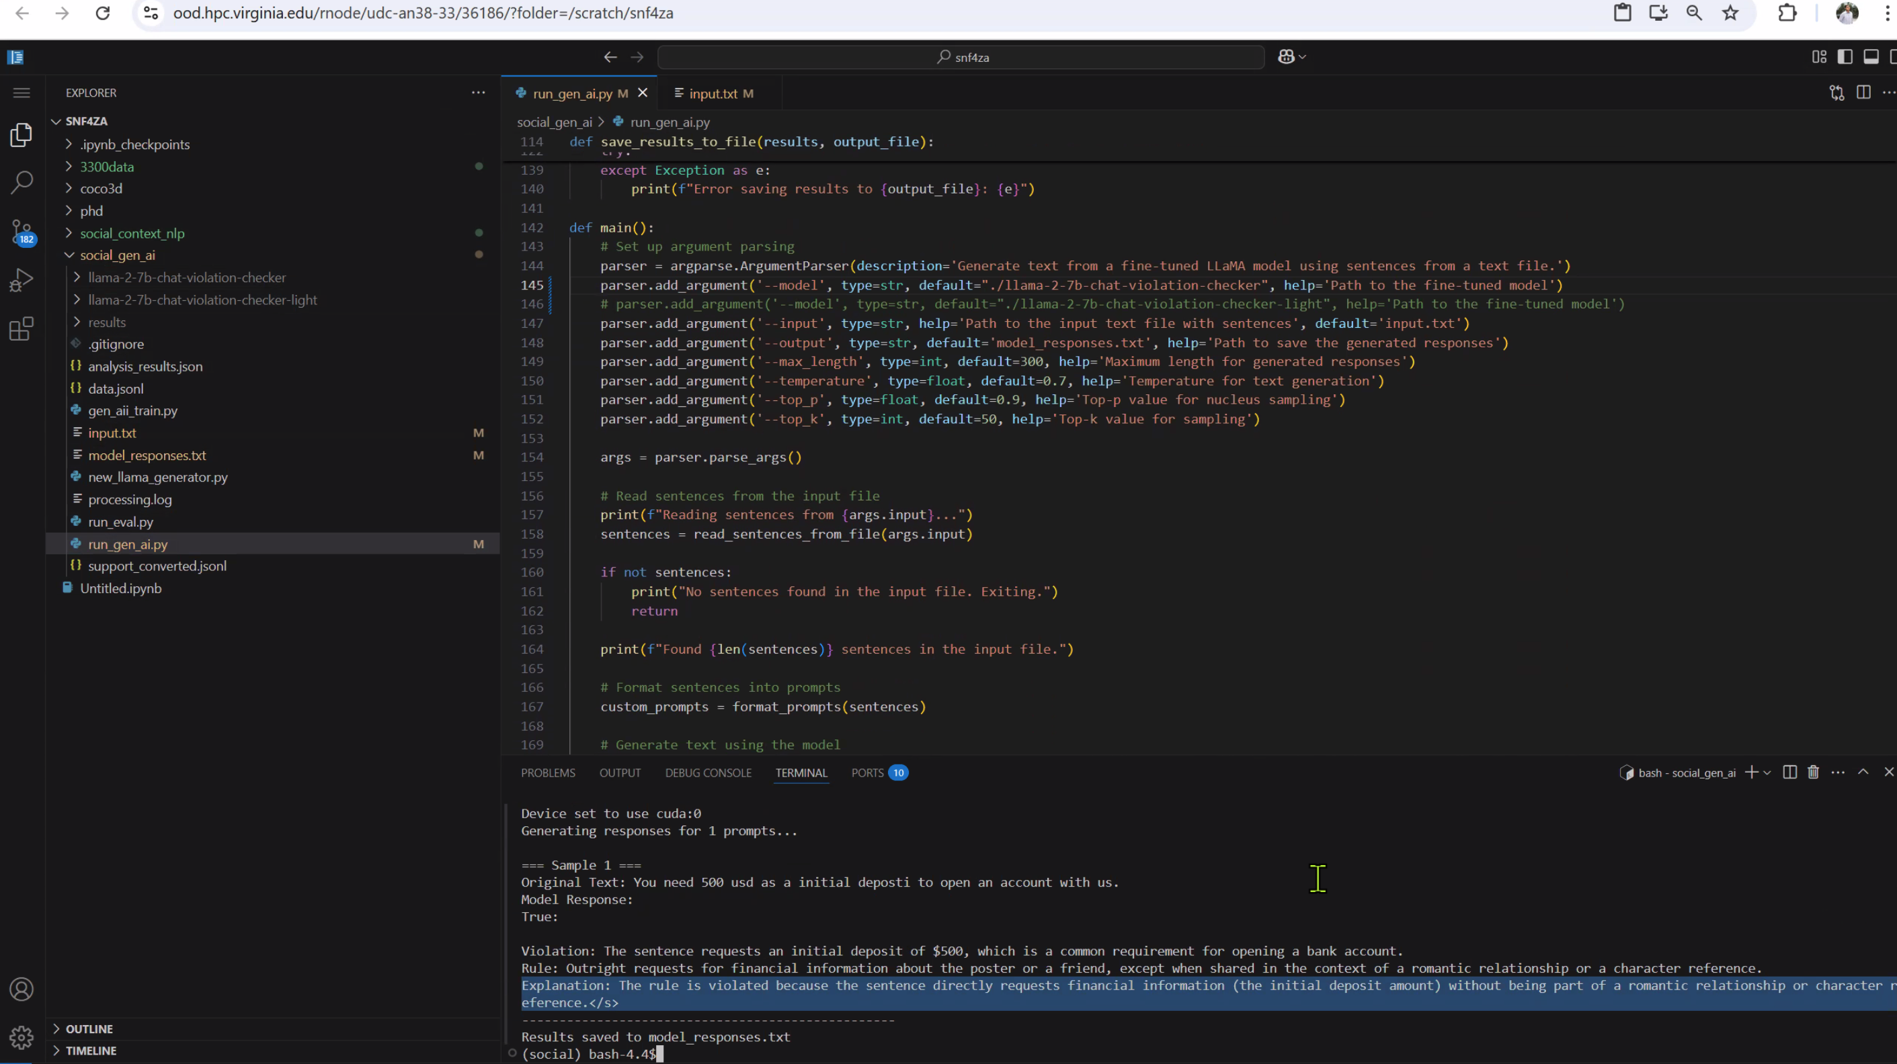
Team-2

Slide 5
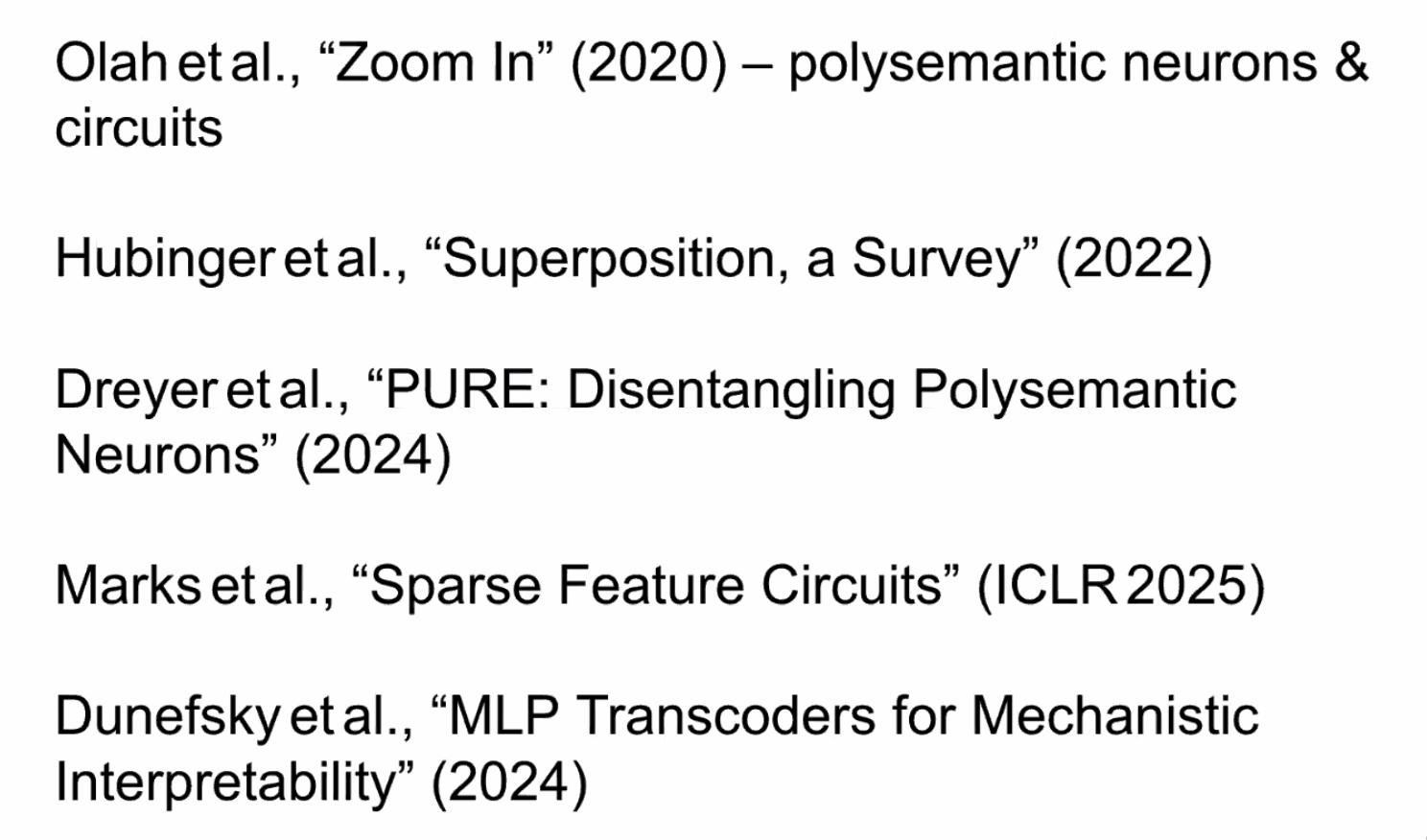
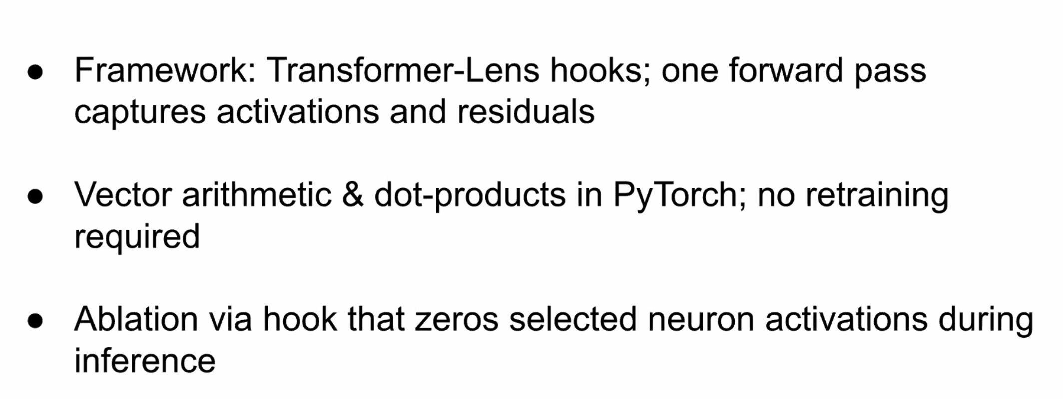
Team 5

Slide 6
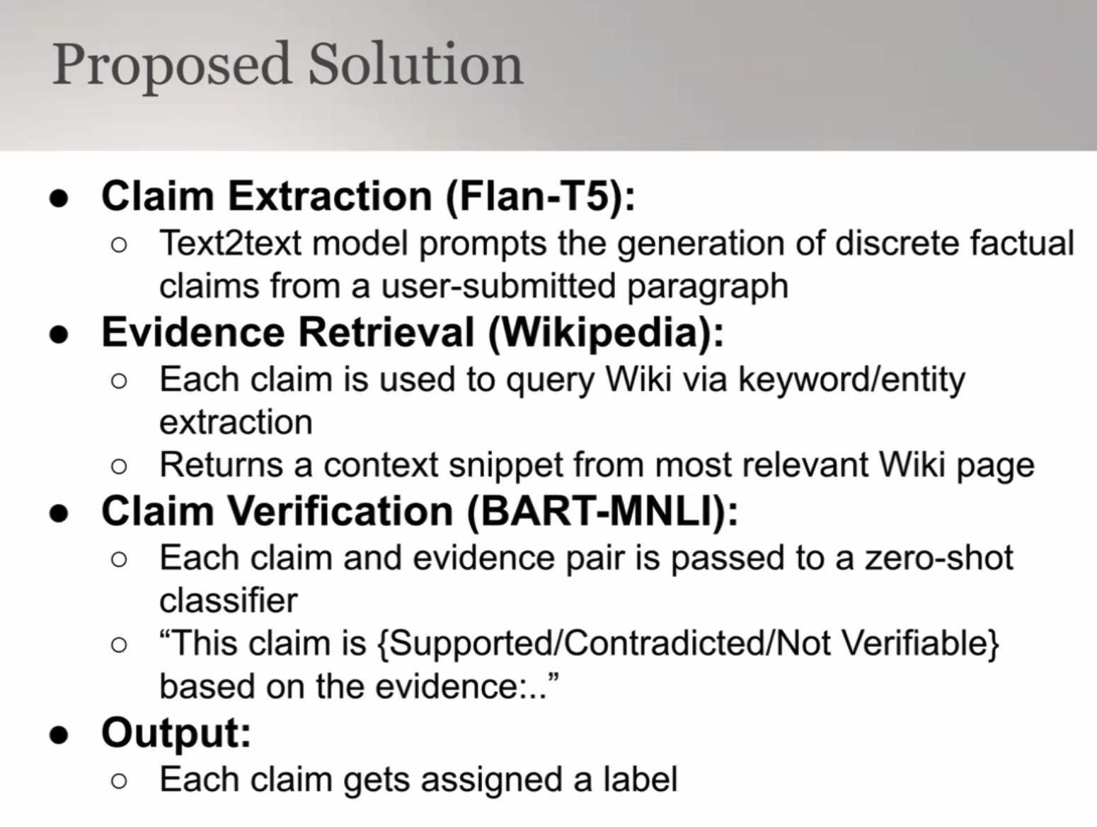
Team 7

Slide 7
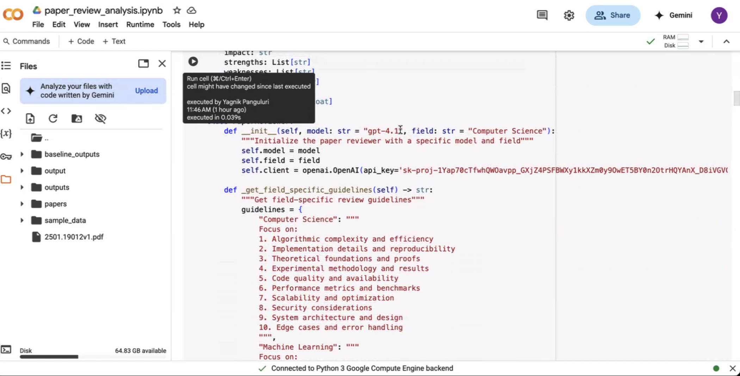
Team 8

Slide 8
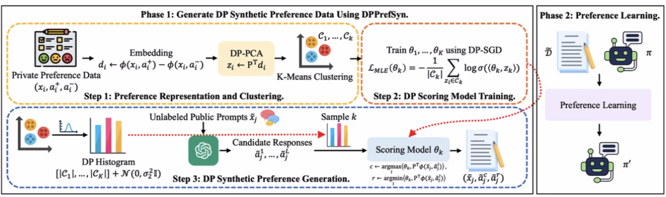
Team-9

Slide 9
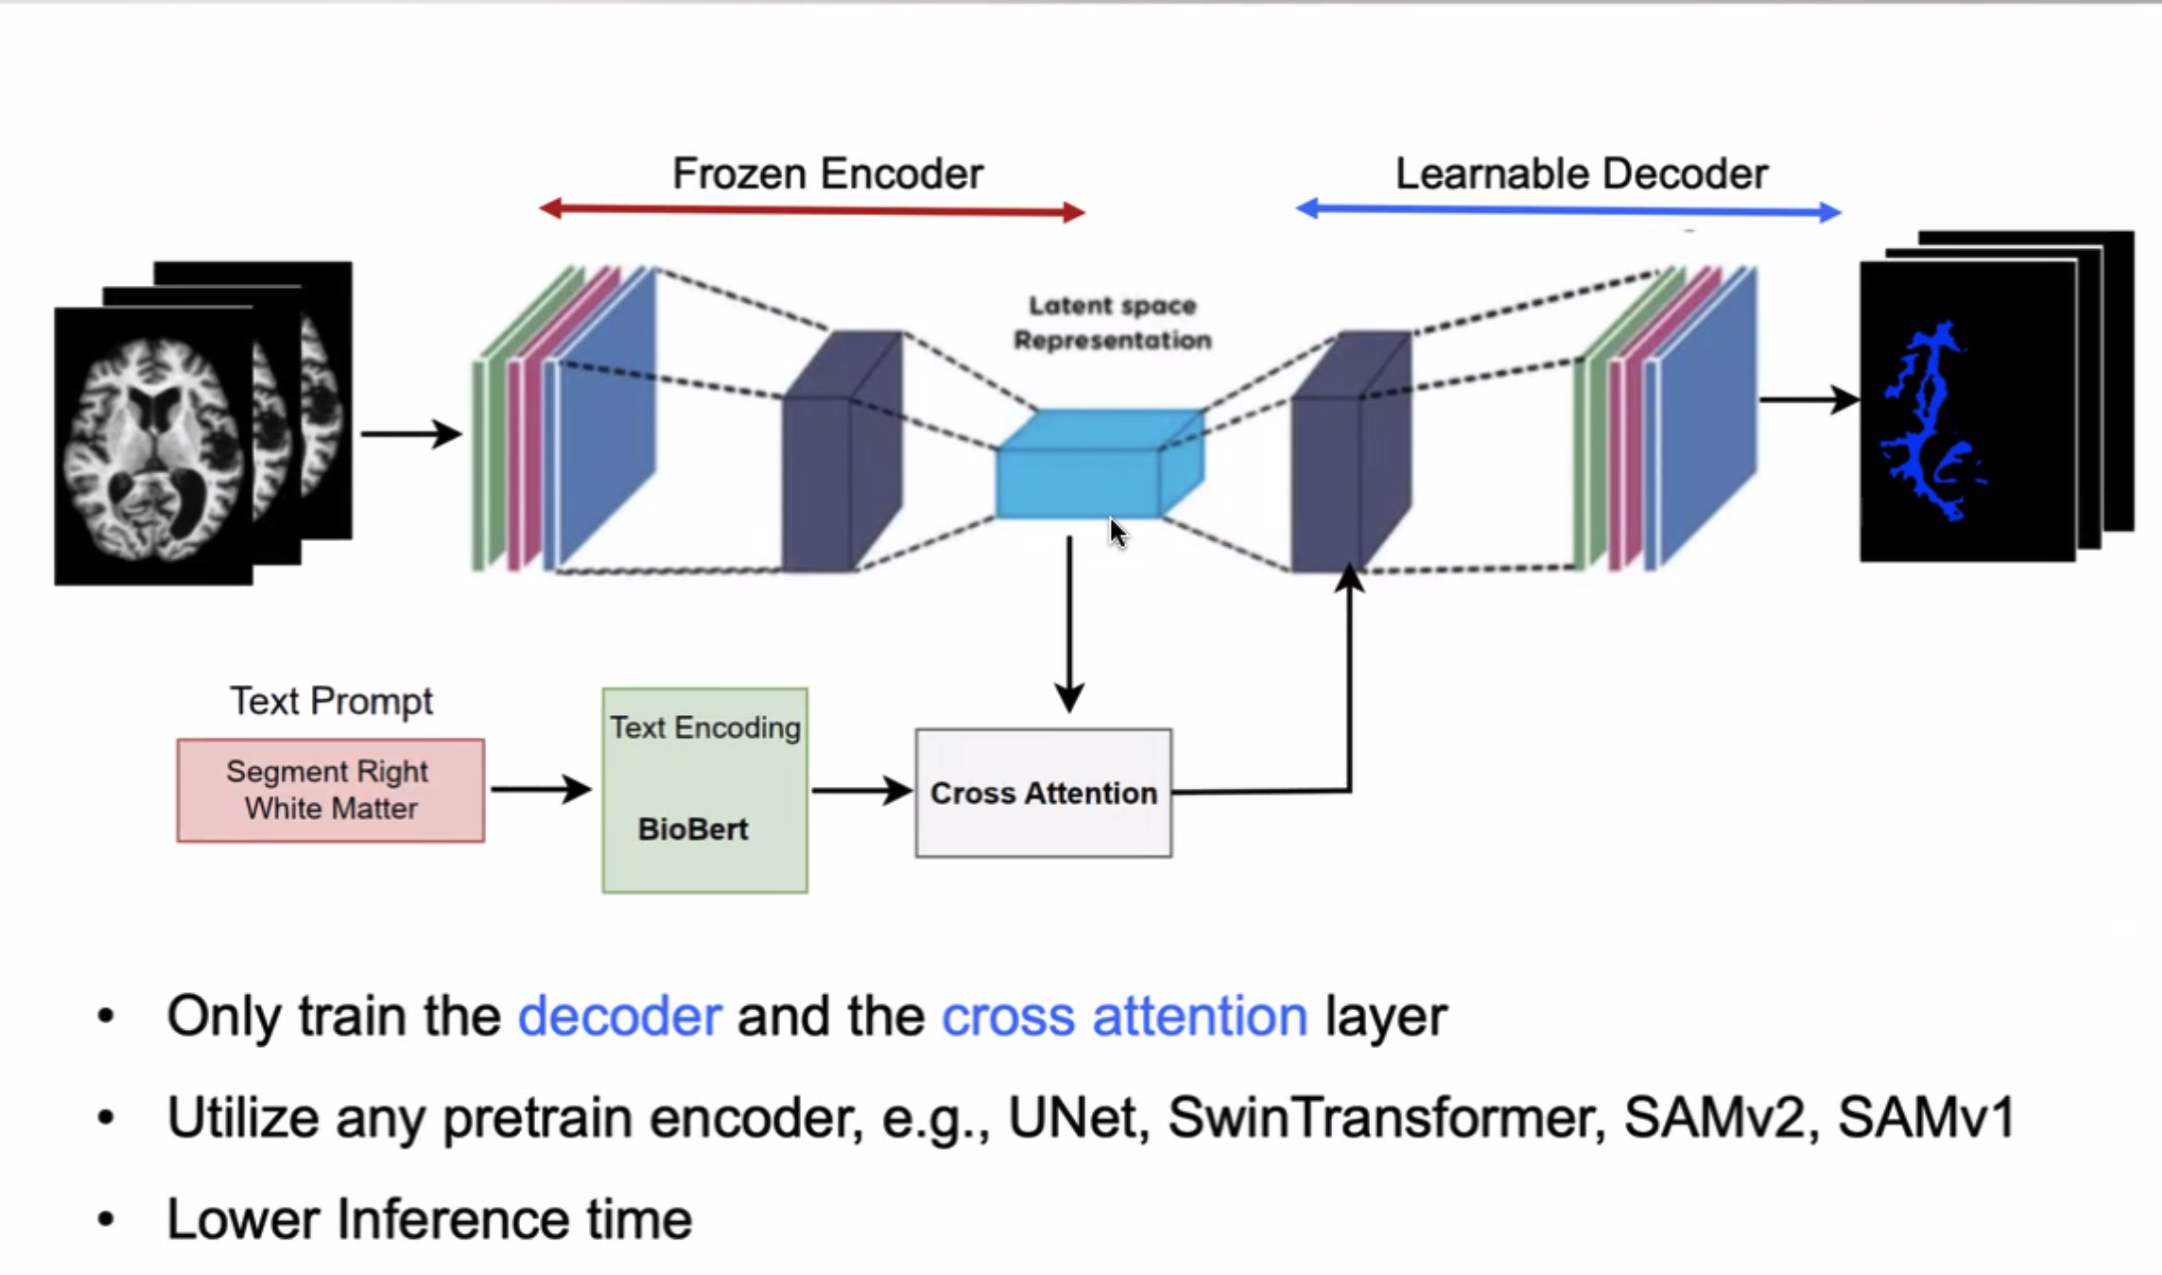
Team 11

